Slide 1


Machine Learning Project
Swiggy
Recommendation Model

Slide 2

AAYUSH KATARIA
ANJALI BAKSHI
MAASAHHEBI USTAAD
MANIKYAM SOMESHWAR
Team
Members

Slide 3

INTRODUCTION
Swiggy, established in 2014, stands as a prominent Indian online food ordering and delivery platform. Its headquarters are situated in Bangalore, and its extensive operations span across over 500 cities in India.
In addition to its core food delivery service, Swiggy has expanded its offerings to include on-demand grocery deliveries under the banner of Instamart. Furthermore, the platform provides a convenient same-day package delivery service known as Swiggy Genie.
The company competes fiercely with the domestic startup Zomato in the realms of food delivery and hyper-local marketplaces.

Slide 4

OBJECTIVES​
1.Data Collection & Processing:
Scrape diverse Swiggy data: restaurant info, user ratings, cuisine preferences, reviews, and locations.
2.Algorithm Design:
Design algorithm to generate personalized recommendations based on past ratings,
cuisine preferences, delivery review number and location.
3.Webpage Development:
Build user-friendly webpage for recommendations.
Include search, menus, reviews, and ratings
.
4.Restaurant Insights:
Aid potential restaurant owners with cuisine offerings and pricing.
Assisting potential restaurant owners in determining optimal cuisine offerings and average pricing for new restaurant ventures.

Slide 5

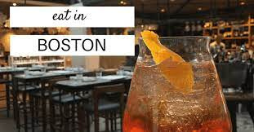
PURPOSE​
Delivers tailored restaurant suggestions to cater to individual preferences.
Promotes user exploration, benefiting restaurant partners' business.
Cuts down user effort in discovering new dining choices.
Streamlines restaurant selection, enhancing user convenience.
Enhances user satisfaction and engagement.
Aligns services with customer preferences and market trends.

Slide 6
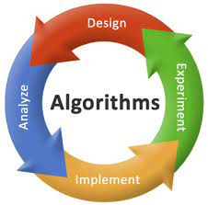
Techniques Implemented
Webscrapping using Beautiful soup & Selenium
Data Cleaning using Excel
Data Processing using Pandas
Model Building using Different Machine Learning Algorithms
Web Page Building using Streamlit Library and Basic CSS

Slide 7

MACHINE LEARNING​​
(Model Building)
Transformed Categorical data into Continuous by utilizing Label Encoder and One-Hot Encoder for effective encoding.
Utilized Linear Regression,Logistic Regression and some other models to forecast the Estimated Price for an item, Location and Cuisine of the Restaurant.
Achieved a remarkable accuracy score with the Linear Regression, whereas the Logistic Regression Model and Random Forest exhibited a modest accuracy .

Slide 8
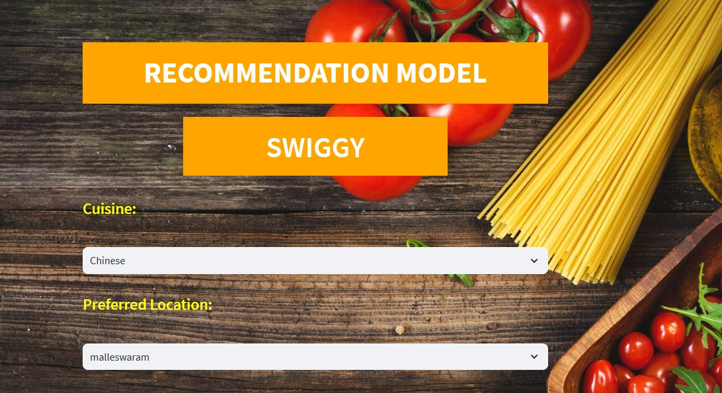
Input From The User

Slide 9
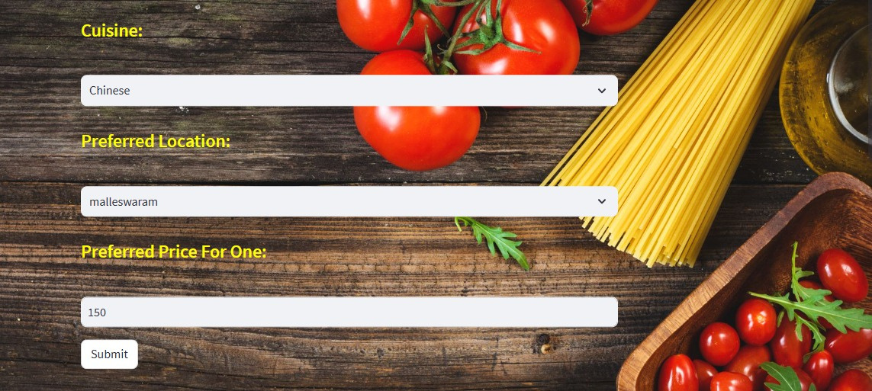

Slide 10
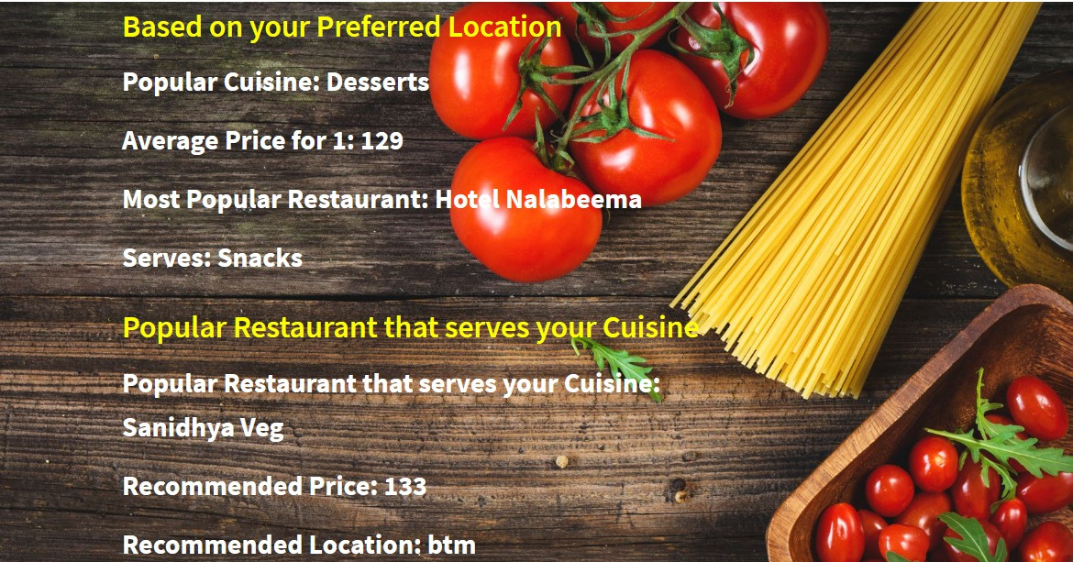
Output

Slide 11

LIMITATIONS & FUTURE WORK​
Limited User and Item Data : The system faces difficulty in delivering accurate recommendations due to insufficient data about users and items.
Solution: Extracting data from alternate data sources can enhance recommendation quality by providing a broader view of user preferences and item characteristics.
Real-Time Updates Challenges : Incorporating real-time updates, such as new user preferences or changes in item availability, is challenging.
Solution: Implement mechanisms to adapt and update recommendations in real-time, ensuring the system remains up-to-date and responsive to user dynamics.

Slide 12

Challenges
Model Accuracy
Web Scrapping
Styling & Integrating Web Page

Slide 13

LEARNING OUTCOMES​
Basic understanding of Machine Learning
Streamlit Python library
Deploying Machine Learning Models on a Webpage
Fundamental Understanding of CSS
Explore model selection, evaluation metrics, and their relevance to delivery predictions
Web Data Scraping
Effective Time Management
Collaborative Teamwork and Coordination

Slide 14
